Slide 1

Building the pipeline
Practical

Slide 2
What will we be doing
We will be using snowpark (snowflakes version of spark) to ingest data.
We will be using a mix of SQL and Python to accomplish this.
We will be using the DataFrame API
Some of the Data we will be ingesting is Parquet, so we will learn abit about schema inference.
We will learn a bit about incremental processing i.e. CDC
Python UDF’s and stored procedures
A few snowflake specific things like warehouse elasticity, Tasks etc
CI/CD integration using GitHub Actions.

Slide 3
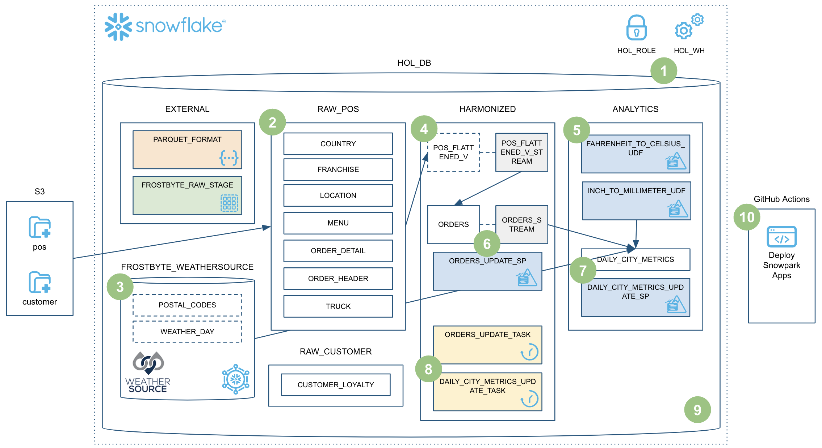
What we will build in a nutshell

Slide 4
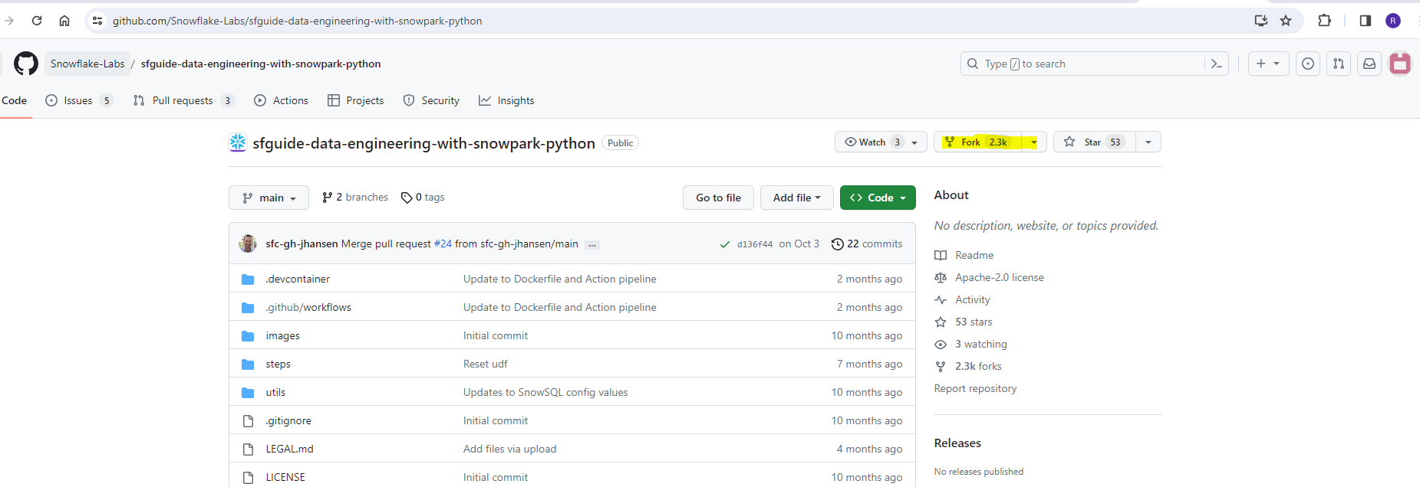
Forking Repo
To start, we need to fork a repo that has the code we will be using to setup the data pipeline. The link to the github Page is in your pack, under day 2.
Once you are on that link, click the fork button.

Slide 5
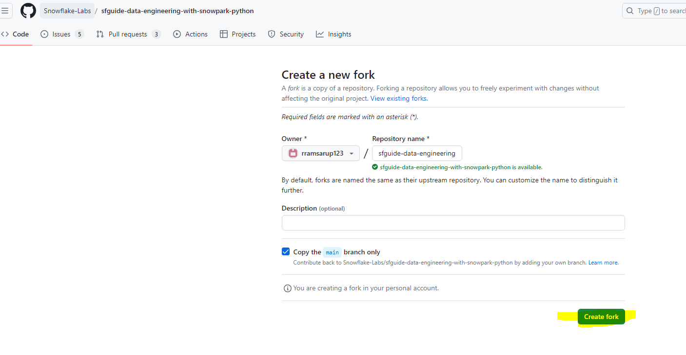
Forking Repo
It will either ask you to login to github or if you are already logged in, it will bring you to this page. Click create fork.

Slide 6
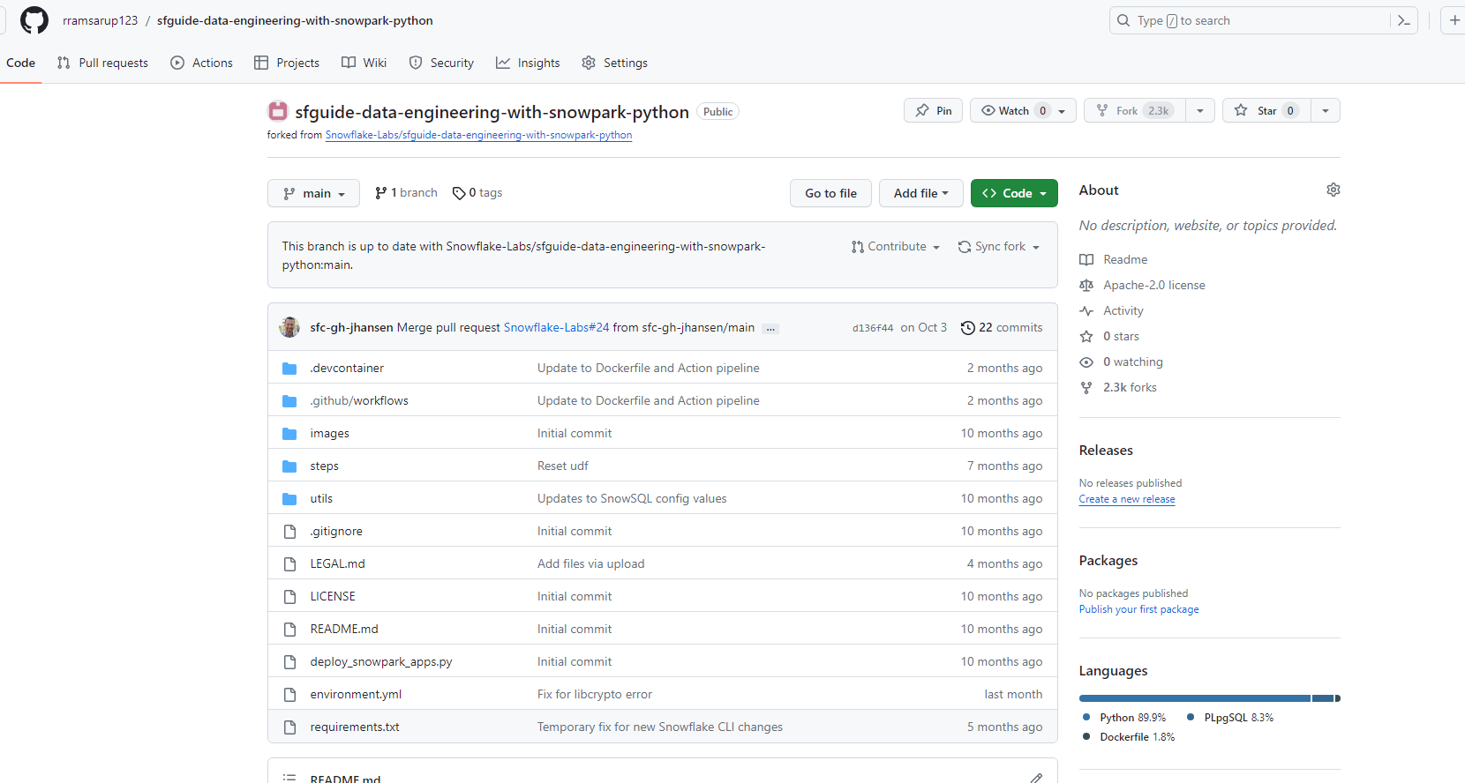
Forking Repo
Once that is complete, you will see your forked copy of this repo.

Slide 7
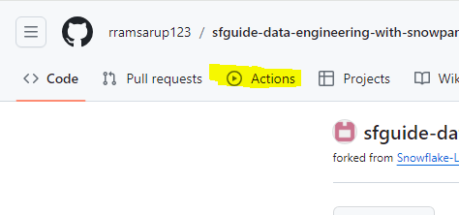
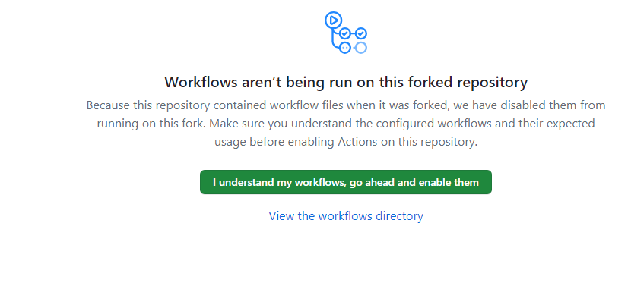
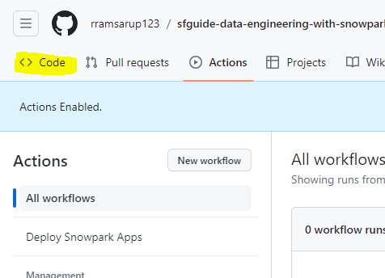
Forking Repo
We then need to enable GitHub actions. Click the actions button at the top left.
Then click the green I understand button
Then click code button to get back to the repository

Slide 8
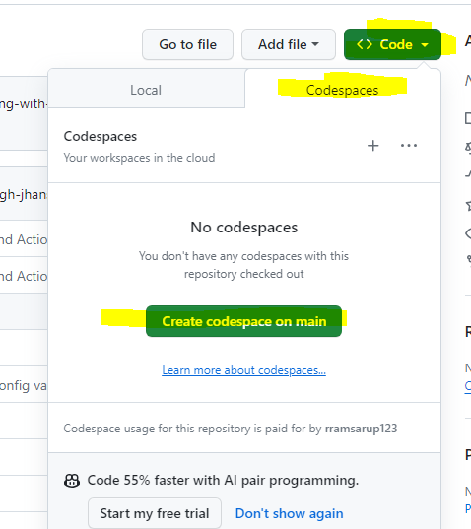
Lets setup our code space
Click the green code button and then the codespace tab, then create codespace on main button. Everything to setup the codespace is provided in the repo.

Slide 9
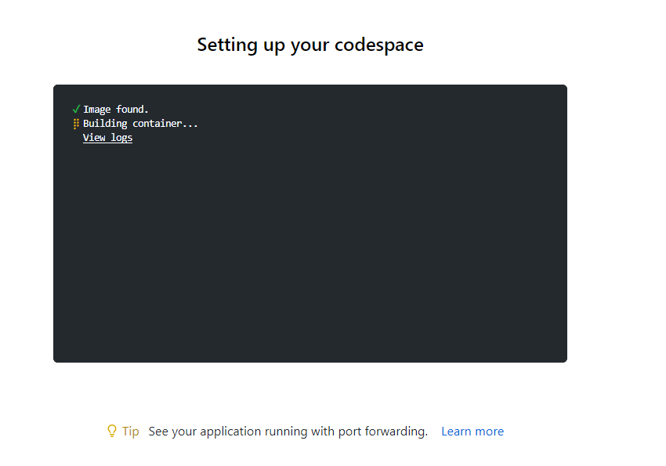
Lets setup our code space
Your codespace will now be built on Github servers. This is the beauty of containers, you will have a container created for you that has all your code and hardware resources, without utilising a full server. This may take a few minutes to provision.

Slide 10
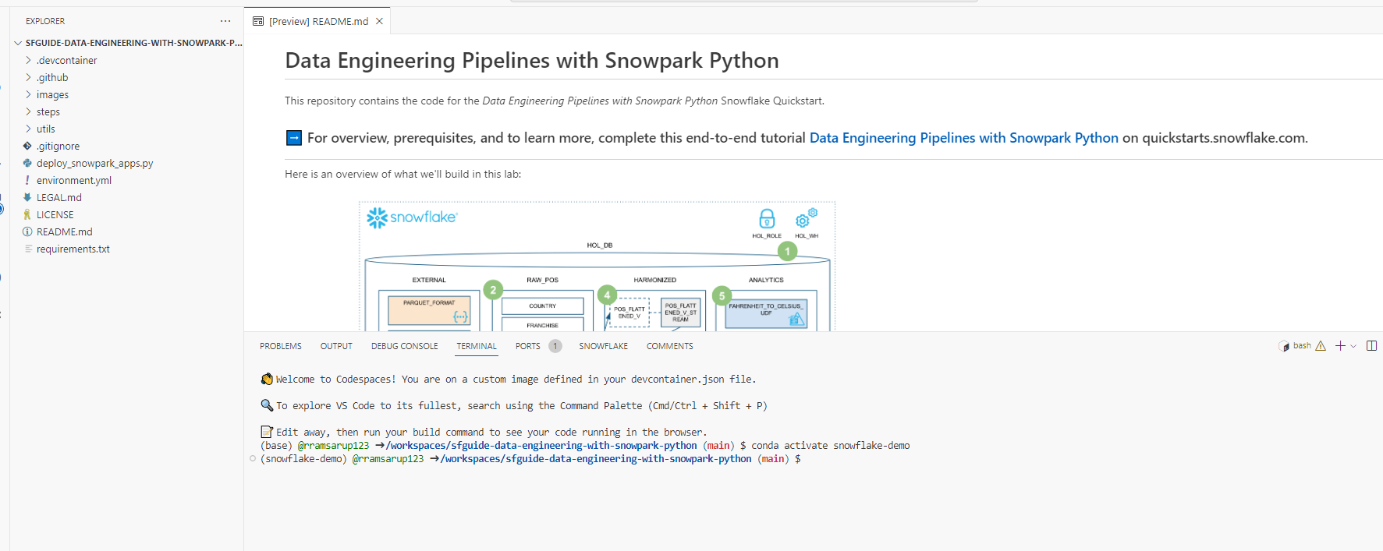
Lets setup our code space
Once setup completes, you will be in your code space

Slide 11
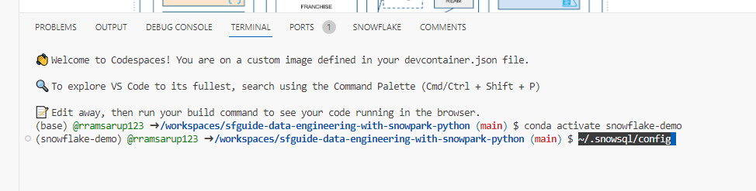
Lets setup our code space
We have a few more steps to complete here. We need to link up this repo with our snowflake account. Run the ~/.snowsql/config command on the terminal.

Slide 12
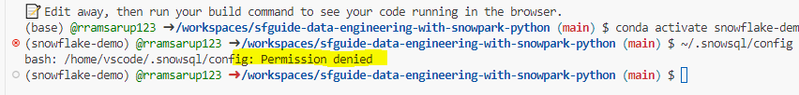
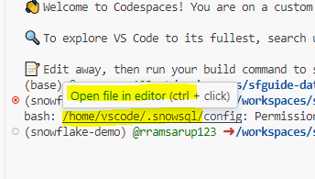
Lets setup our code space
If you get a permission denied error like below
Hover over the file and control click and it will open it up.

Slide 13
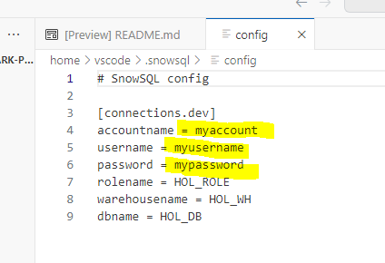
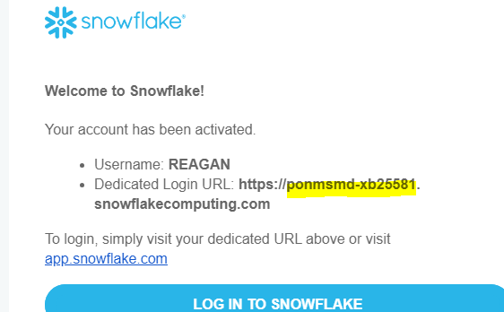
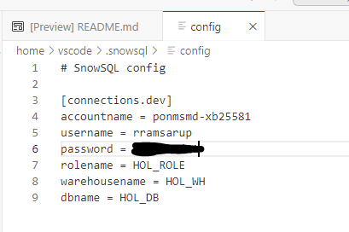
Lets setup our code space
The file should now pop open in your main editor. We will update these 3 fields. Fill it in. (account name is the highlighted part from the screenshot below and username and password is the one you setup for snowflake. Hit control s once done.

Slide 14
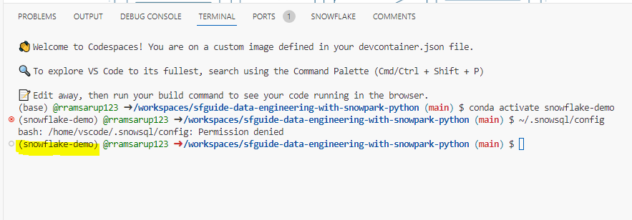
Lets setup our code space
Lastly we need to make sure that python is running on this container. If your terminal is pointing to the anaconda environment i.e. snowflake demo, you are all good, if not then there is a script to run to set that up in the pack. Only run it if you don’t see the highlighted portion in your terminal.

Slide 15
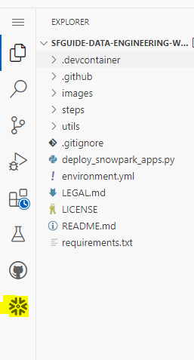
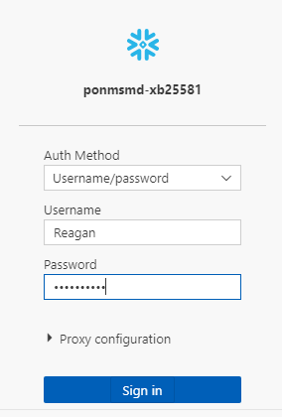
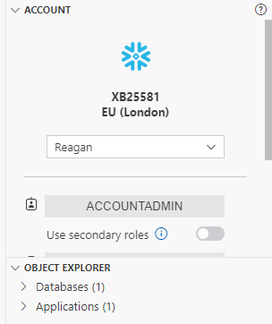
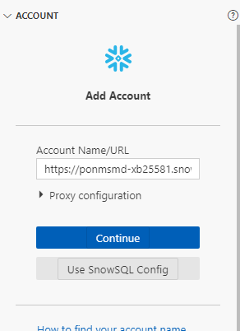
Lets setup the snowflake extension
Snowflake has built in integration with VSCode (that is what we are using in our code space). In our code space, click the snowflake icon.
Copy the account URL from your email and past it in the account name and hit continue
Fill in your username and password and sign in.

Slide 16
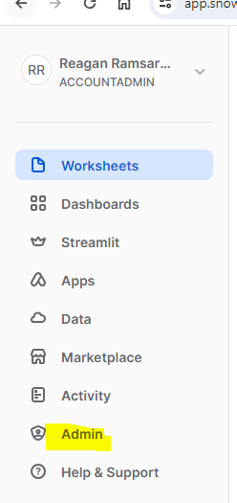
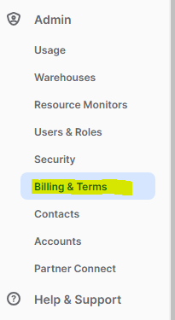
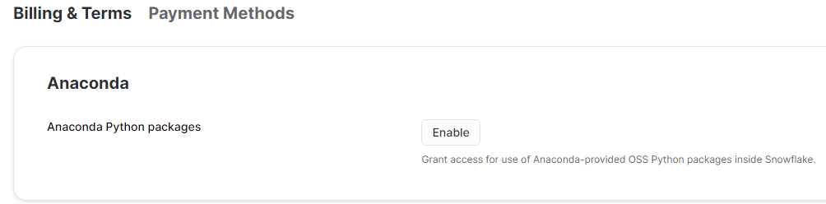
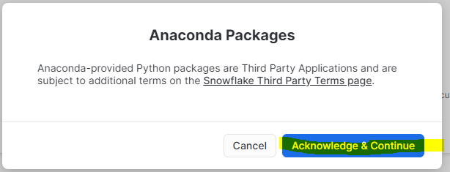
Before executing
Before we start executing things we need to enable python on the snowflake side. So login to snowflake using chrome.
Under Admin
Billing and Terms
Click enable anaconda packages

Slide 17
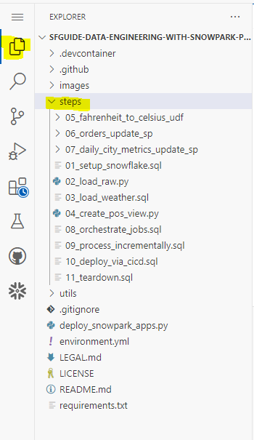
Lets Start
If you go back to your explorer. You will see a steps folder. All the stuff we will be doing with the data is contained in this. The code is already written, we will just understand it and execute.

Slide 18
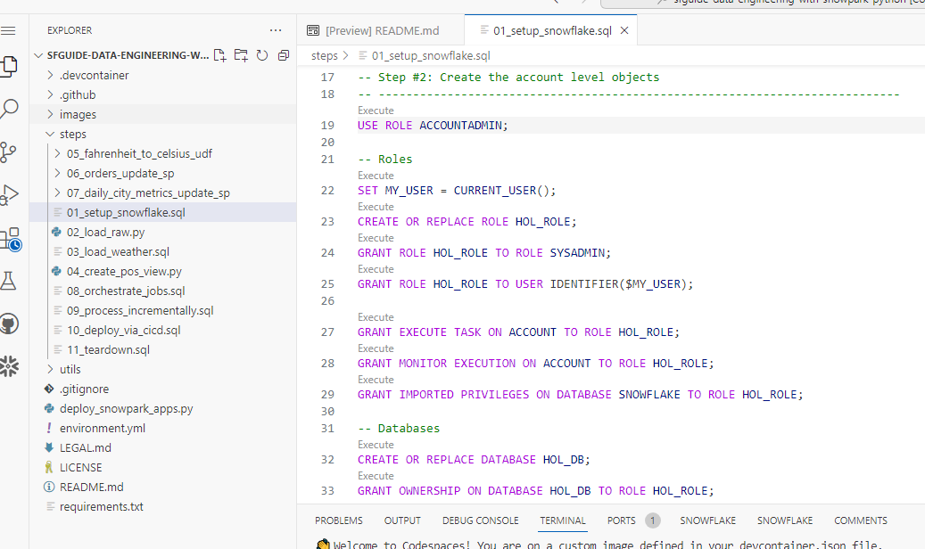
01_setup_snowflake.sql
Double click the file to open it. Read through the code and see if you can understand what is happening.

Slide 19
01_setup_snowflake.sql
What is happening in this script.
In a nutshell, we are creating roles (security) and granting permissions to the roles.
We are also creating databases and warehouses and assigning ownership of it to roles.
We are then creating schema’s within databases.
We are creating file formats (file formats are objects that snowflake uses to understand how to interpret files)
We are creating stages (stages are used by snowflake to store files, before we load them into tables)
We are also creating a function.

Slide 20
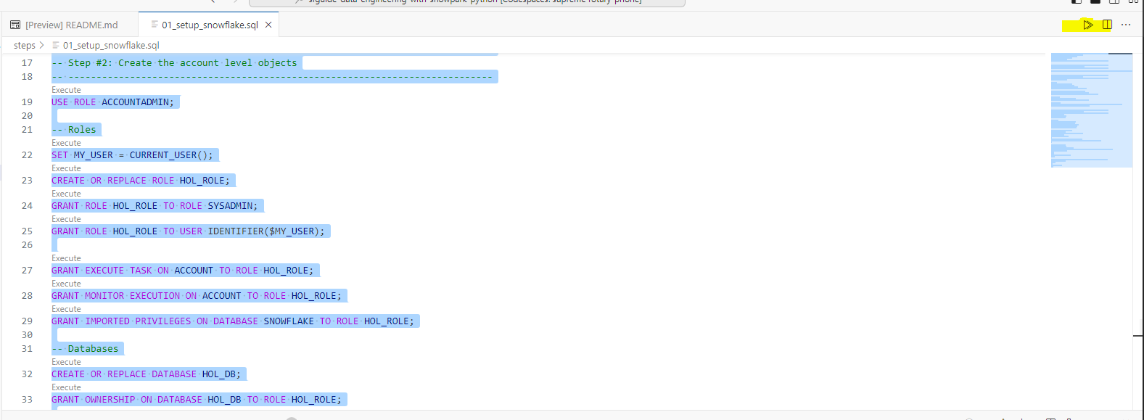
01_setup_snowflake.sql
Highlight all the code by clicking control and A and then execute it using the run button.

Slide 21
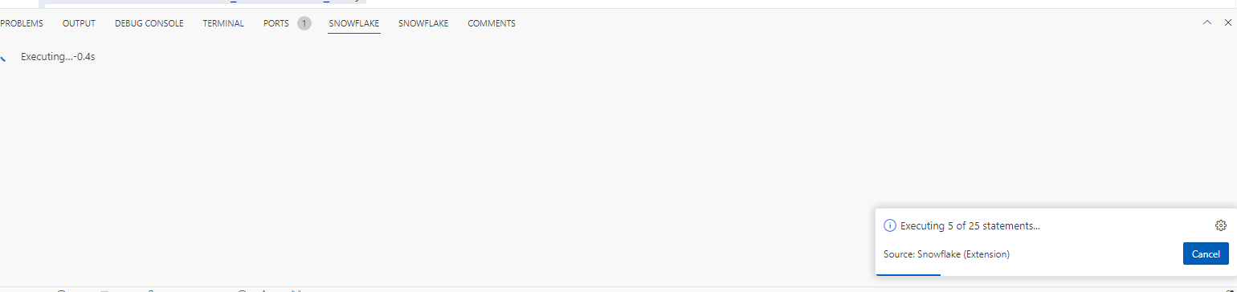
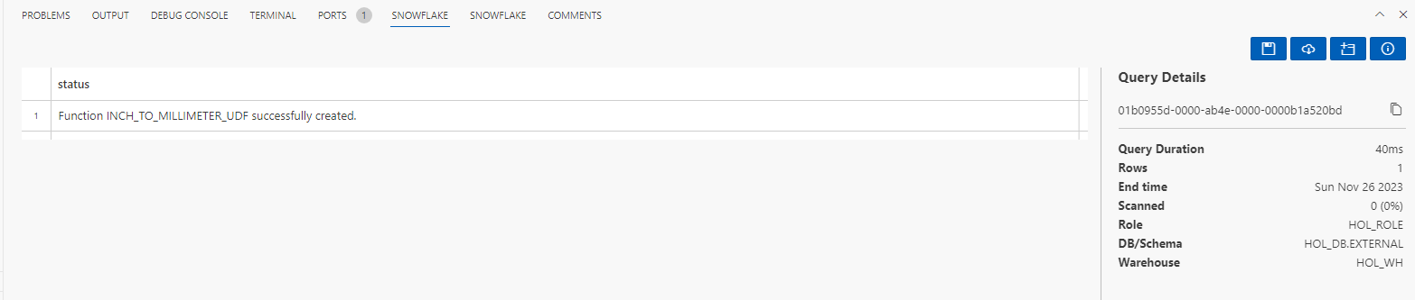
01_setup_snowflake.sql
You will see it executing multiple things

Slide 22
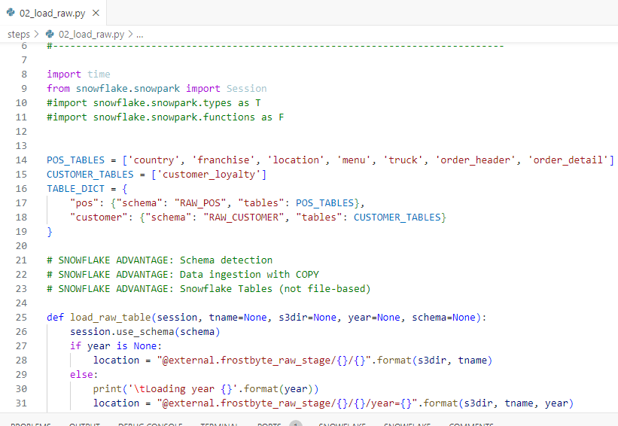
Loading Raw Data – 02_load_raw
Next we will be loading raw data from Parquet files.
Lets open the 02_load_raw.py and lets see if we can understand what is happening there.

Slide 23
Loading Raw Data – 02_load_raw
What is happening?
We can see that we are importing some libraries
We are creating some variables to hold structures
We are creating a function that reads the parquet data into a data frame (take note of the Parquet read function, this allows us to infer the schema based on the data)
We then have a function that does the actual data load
We then have a validation function that checks that the column names are correctly inferred from the schema

Slide 24
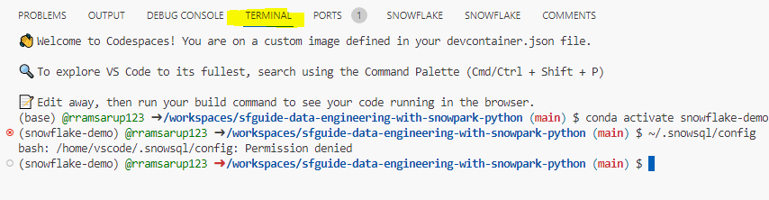
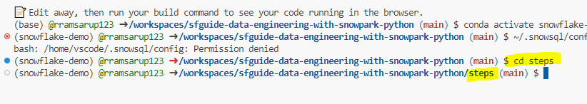
Loading Raw Data – 02_load_raw
Lets run this. Head to the terminal
Lets navigate to the steps folder by running the command cd steps

Slide 25
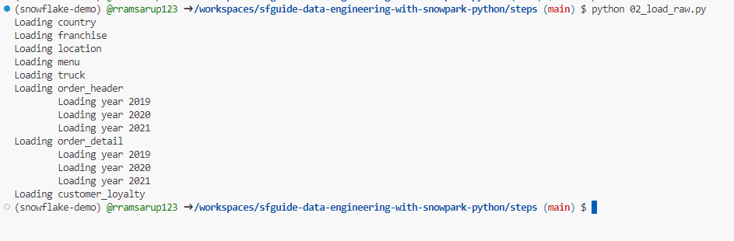
Loading Raw Data – 02_load_raw
Now run the load raw python script using the python 02_load_raw.py command
You will see that it will start loading the various tables. At the end it should look like the below:

Slide 26
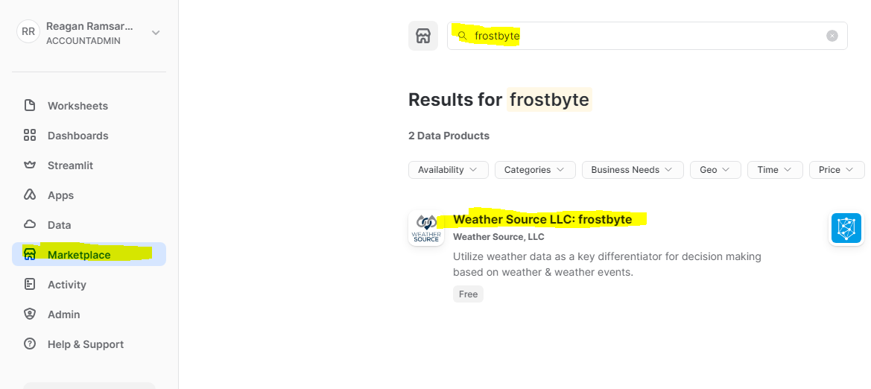
Weather Data
Now lets pivot back over to snowflake, we are going to get some shared data.
Click on marketplace and in the marketplace search frostbyte and select the highlighted source.

Slide 27
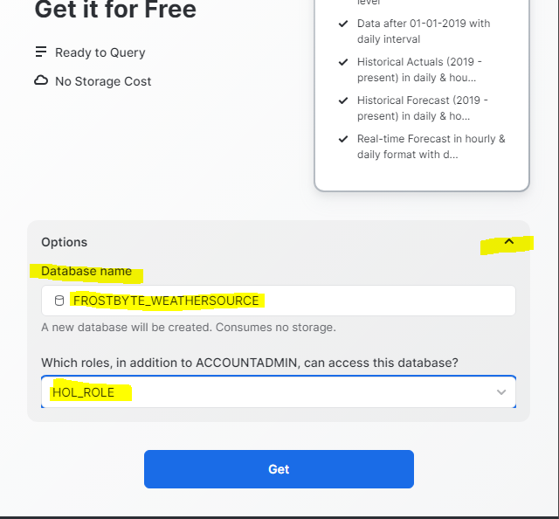
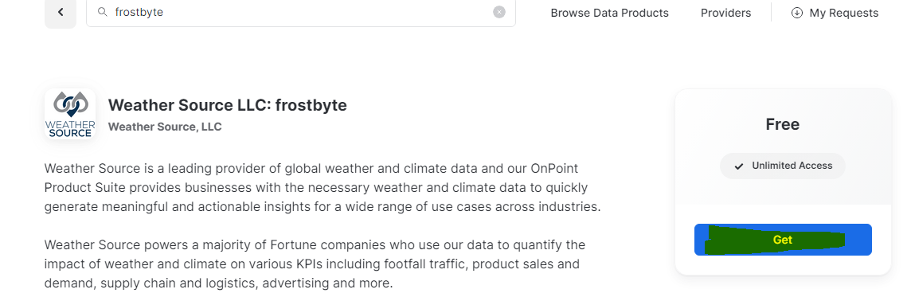
Weather Data
Click Get and ensure database name is set to FROSTBYTE_WEATHERSOURCE and role is HOL_ROL, then click get. Then Done.

Slide 28
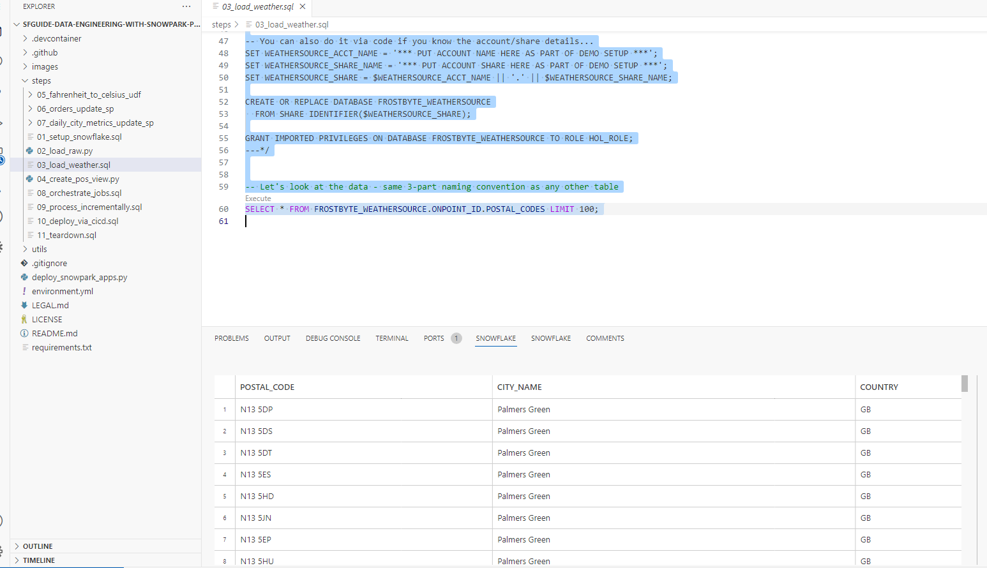
03_load_weather
Lets open up 03_load_weather.sql
It is just a select to test that we have consumed the data successfully. Execute the script and you should get some results back.

Slide 29
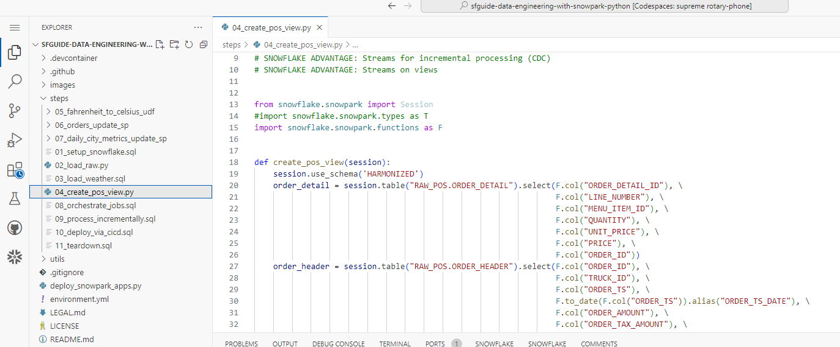
04_create_pos_view.py
Open up this script and lets see if we can understand what is going on here.

Slide 30
04_create_pos_view.py
So what is going on in this script?
Firstly we are importing a few functions from snowpark.
We are defining a few views using the snowpark dataframe api.
We are then combining these views to make one final view, this is basically using dataframes to mimic a SQL query.
We are then using snowflakes stream function to allow us to load data using CDC, i.e. only processing new and changed data. Traditionally this was done using a high watermark, however the snowflake stream function makes it easy for us to do this.

Slide 31
04_create_pos_view.py
Lets execute this script. Run this script by going to the terminal and entering the python 04_create_pos_view.py command. Once the command prompt shows up again, that means the script has completed.

Slide 32
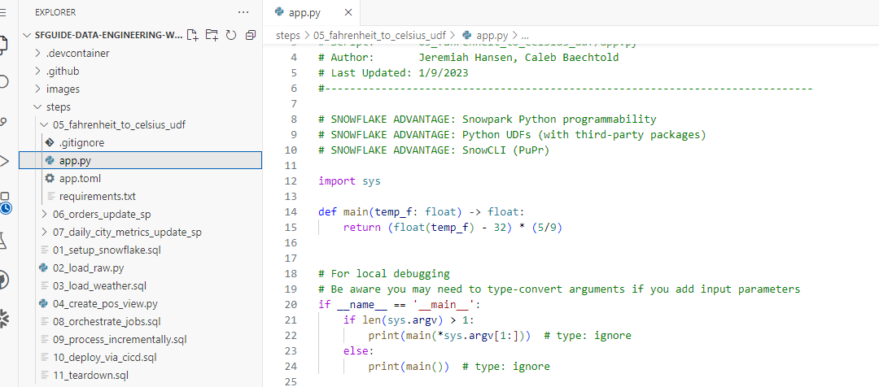
05_Fahrenheit_to_celcius_udf
Have a look at the folder 05_Fahrenheit_to_Celsius_udf, specifically the app.py script, can you understand what it does?
It’s a very simple function that takes in one parameter and converts the value to Celsius.

Slide 33
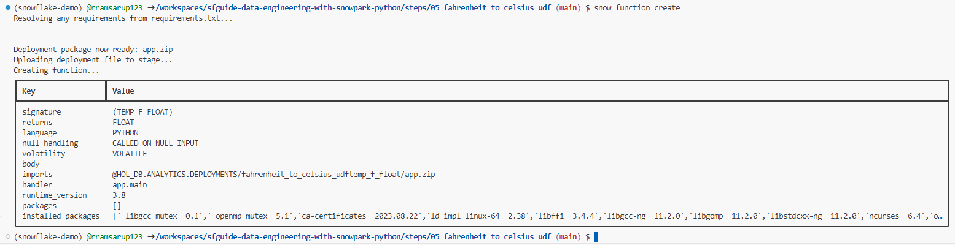
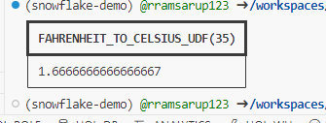
05_Fahrenheit_to_celcius_udf
If you navigate to the folder in your terminal using cd 05_fahrenheit_to_celsius_udf
And run python app.py 35, it will run that function with a value of 35 and return a result
While still in this folder, lets create the function on snowflake using the snow function create. After creation you can run the function using
snow function execute -f "fahrenheit_to_celsius_udf(35)"

Slide 34
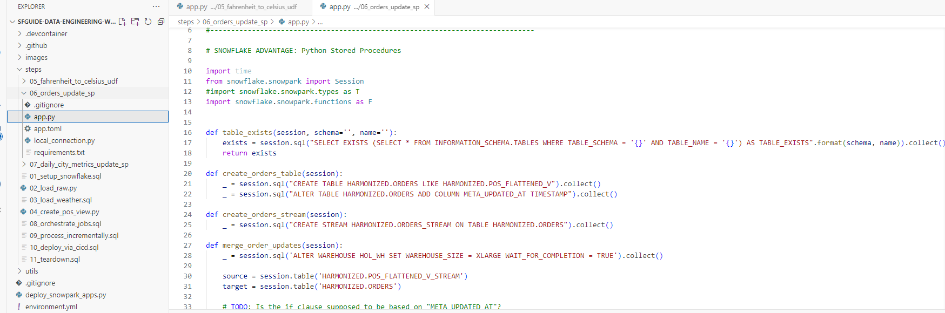
06_orders_update_sp
Open up the app.py file in 06_orders_update_sp. Lets have a look here and see if we can understand what the code is doing.

Slide 35
06_orders_update_sp
So what is happening in this package?
As with most python scrips, we have a few imports for items we need.
We have a function that checks for the existence of tables, this is called defensive coding, if we know something is not in place, we can handle it, instead of finding out mid script that something is not in place and having the system error out.
We have a few more functions that simply open up a sql session and pushes some sql through to snowflake
We then ensure our stream is setup correctly and that the correct high watermark column is set.
We then process a load into a table.
You will see in the main function, we create the tables if they don’t exist, if we just assumed they existed, the solution will bomb out if they didn’t.

Slide 36
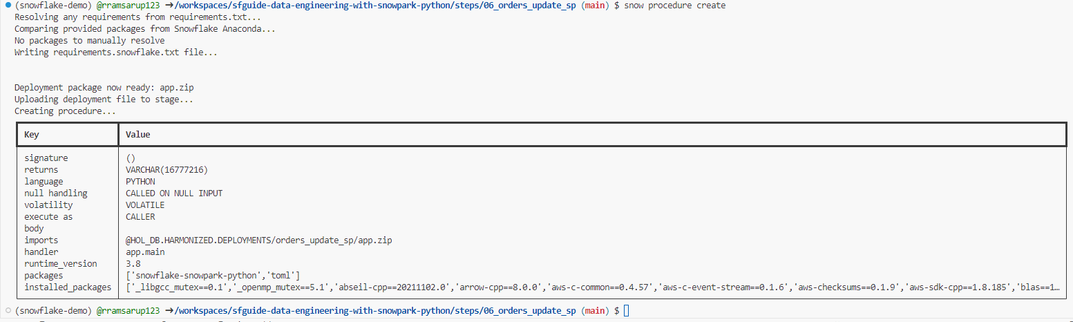
06_orders_update_sp
Lets navigate back to the steps folder by using cd ..
Then lets navigate to the 06 folder by using cd 06_orders_update_sp
Then lets create the procedure by using snow procedure create
Then lets run the procedure by using snow procedure execute -p "orders_update_sp()"

Slide 37
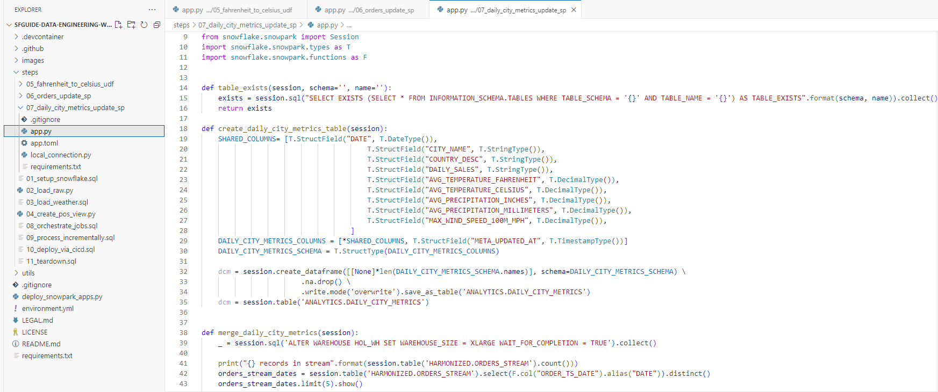
07_daily_city_metrics_update
Open up the app.py file in 07_daily_city_metrics_update_sp. Lets have a look here and see if we can understand what the code is doing.

Slide 38
07_daily_city_metrics_update
So what is happening in this package?
As with most python scrips, we have a few imports for items we need.
The first thing we are doing is creating a function that explicitly defines the schema for the table that we want to load.
We are once again using the dataframe api to help us read and write data to the table.
We are then creating an aggregation in flight using the dataframe API, similar to how we would in SQL, you will notice there is a lot of overlapping functionality.
We are then fine tuning our stream to set high watermarks
Once again defensive coding is in play, we will then create the table if it doesn’t exist and then write to it.

Slide 39
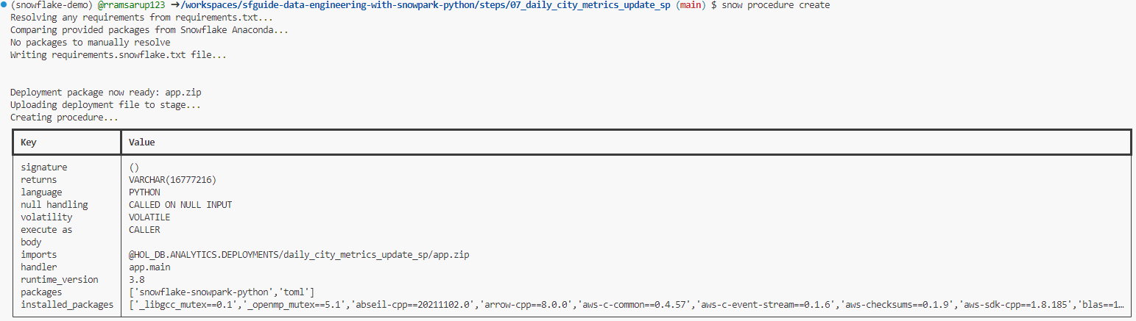
07_daily_city_metrics_update
Lets navigate back to the steps folder by using cd ..
Then lets navigate to the 07 folder by using cd 07_daily_city_metrics_update_sp
Then lets create the procedure by using snow procedure create
lets run the proc using snow procedure execute -p "daily_city_metrics_update_sp()"

Slide 40
Orchestrating Jobs
Job orchestration can be done in many ways, there are tools that are built for this purpose i.e. Automic enterprise scheduler, data services etc.
However most tools / DBMS have some method of orchestration either via CRON jobs or some other mechanisim.
Snowflake has a feature called tasks, we will use this to handle orchestration for the items we just built.

Slide 41
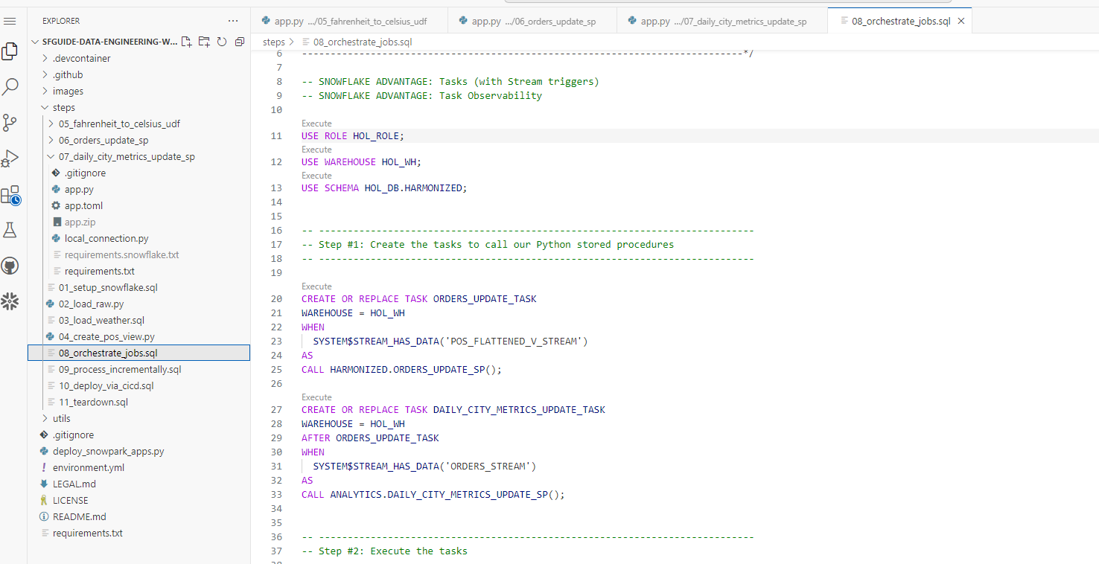
Orchestrating Jobs – 08_orchestrate_jobs
Open the script 08 Orchestrate Jobs, lets try and understand what the code is doing.

Slide 42
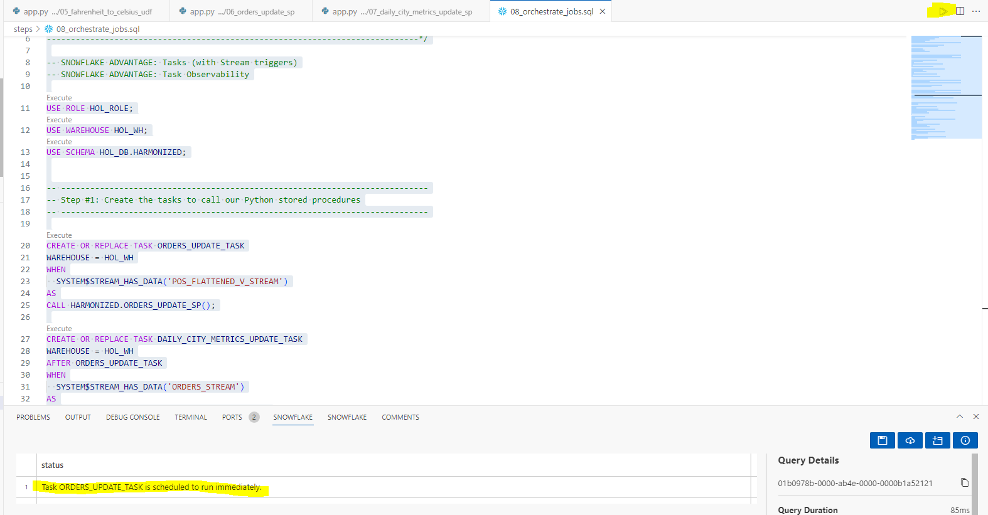
Orchestrating Jobs – 08_orchestrate_jobs
What is the code doing?
We can see that the script is creating tasks which are a snowflake orchestration object.
We can see it makes use of snowflake streams, which gives you the ability to check if any of the streams we created earlier has data.
If there is data, the stored proc to call the stream is executed.
Lets go ahead and select all the SQL and run it.

Slide 43
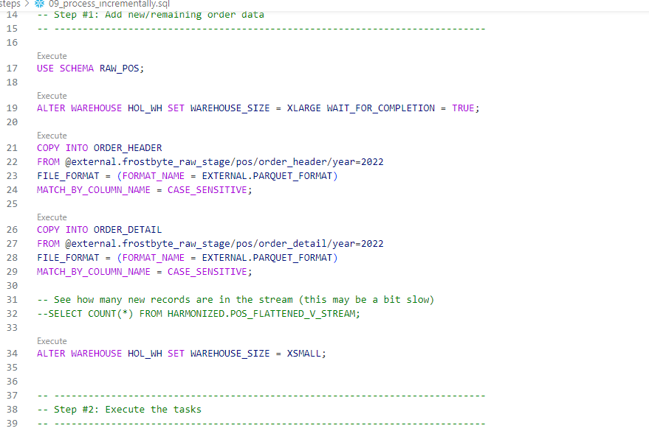
Processing Incrementally – 09_process_incrementally
Open the script 09 Process Incrementally, lets try and understand what the code is doing.

Slide 44
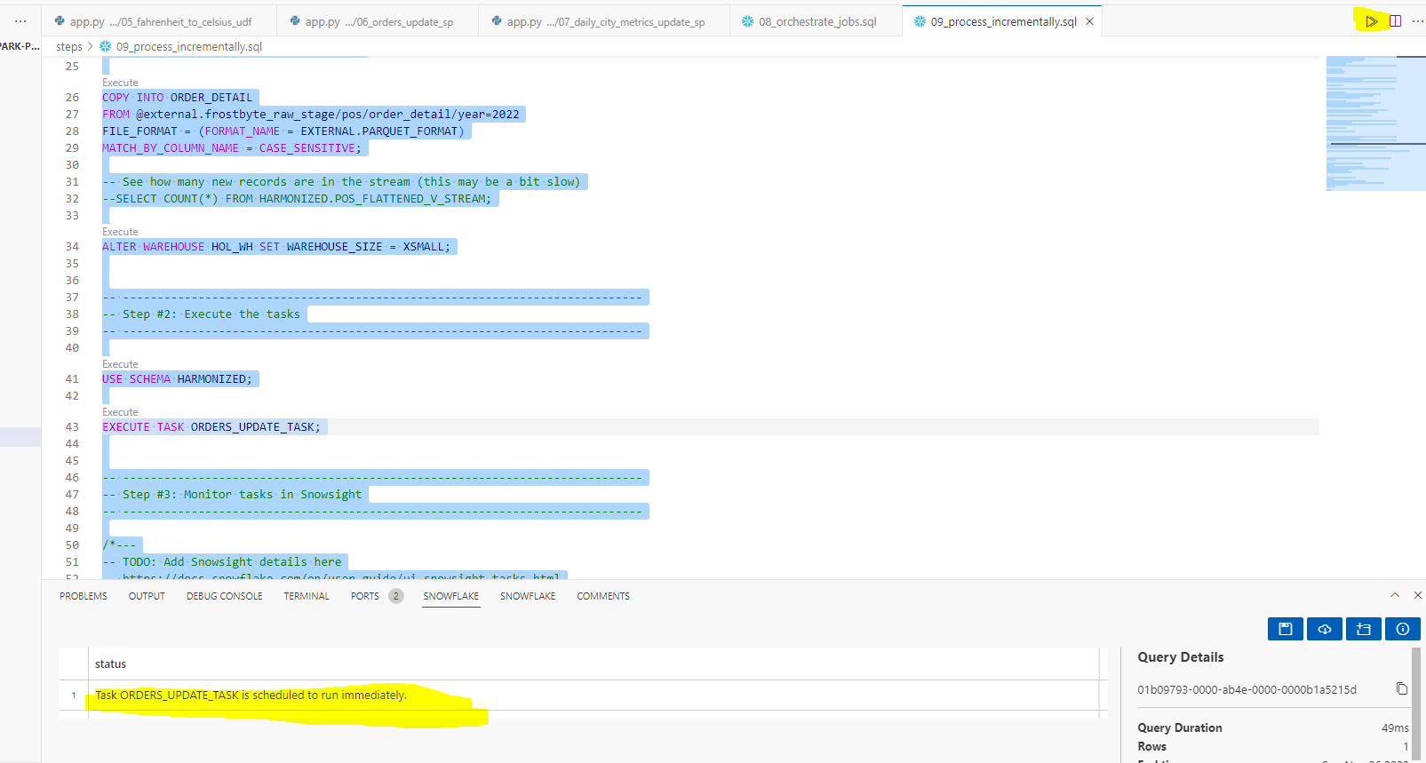
Processing Incrementally – 09_process_incrementally
We can see that the code is copying data from a stage into the raw POS table.
We are then calling the Task to update orders. Lets run this, select all and execute.

Slide 45
Deploying code via CI/CD
The last piece of this section of the module, is to deploy our code to the main repo using a CI/CD pipeline.
In order to do this, we would need to make some adjustments to the code, so that we have changes to deploy.
We will be updating the Fahrenheit to Celsius udf to use a library instead of a hardcoded constant.

Slide 46

Deploying code via CI/CD
Open the Fahrenheit to Celsius app.py and change the highlighted code to this:
import sys
from scipy.constants import convert_temperature
def main(temp_f: float) -> float:
return convert_temperature(float(temp_f), 'F', 'C’)
It is in your code pack

Slide 47

Deploying code via CI/CD
It should look like this when complete. Hit control s to save.

Slide 48

Deploying code via CI/CD
Because we are using a new library, we need to also include it in our requirements file. So open that up and add the highlighted line.

Slide 49

Deploying code via CI/CD
We then need to locally test the code. To do this lets navigate to the 05 folder, you can do this by cd .. Until you get to the steps and then cd to 05 folder. This should be familiar to you now as we navigated a lot this way.
We then need to install the packages in our requirements file, do this using
pip install -r requirements.txt
Now lets test our function by running it locally using python app.py 35

Slide 50

Deploying code via CI/CD
Great, so we are comfortable that the changes we made to the function still works. Lets move on to setting up the deployment pipeline.
We first need to Setup our credentials on GitHub so that it can deploy to snowflake.
To do this we will use the secrets feature of github. To get there, go to your github account(the account page, not the code spaces we have been working on)
Click on settings

Slide 51




Deploying code via CI/CD
We want this list created, only the first 3 require your details, the rest must contain the value displayed
Then secrets and variables, then actions
Click on new repository secret, then add a name and the secret

Slide 52

Deploying code via CI/CD
When complete, you should have these secrets setup:

Slide 53




Deploying code via CI/CD
Now head pack to your code space, we need to commit the changes we just made and push it to our repository. Click the highlighted source control button, you should see two changes on it.
Enter a message in the commit box and hit commit
Say yes here
Then click sync changes and ok on the popup

Slide 54

Deploying code via CI/CD
We already have a very simple pipeline configured on this repo. It can be viewed here

Slide 55

Deploying code via CI/CD
The moment that we pushed (synced) our changed to the repo, the workflow would have kicked off as it has a trigger to build when changes come in. Lets go have a look at our workflows in the actions tab.

Slide 56



Deploying code via CI/CD
Click on the latest run that has the comment you added in your commit, in my case it’s the changed the function one.
Then hit the deploy button to Have a look at the logs

Slide 57
Questions?

